Slide 1

Master Your Data: The Easy Guide to Better Insights
A Beginners Guide to Leveraging Business Data
Created by Sarah Gessler in Collaboration with LaConte Consulting

Slide 2

Does This Sound Like Your Business?
Despite having tried our best to organize our data, we still experience…
  Inefficient Decision-Making
  Compliance Risks
Missed Opportunities
  Data Overload
  Increased Costs
  Customer Dissatisfaction
  Lost Insights
  Loss of Competitive Edge

Slide 3
If this sounds like your business, then you are likely considering how you can implement better data practices
This guide will walk you through a system that can be used to extract value from your data in-house
In the end you will not only be able to make more data-driven business decisions, but you will also have a strong foundation to effectively organize information in a way that is informative and directional

Slide 4
This Guide Includes:
1. What are Pivot Tables?
2. How Pivot Tables Help With Data Management
3. Common Objections to Pivot Tables
4. How to Create Pivot Tables in Microsoft Excel
5. The Benefits & Limitations of Pivot Tables
6. Common Challenges With Pivot Tables & How to Overcome Them
7. General Tips to Improve Pivot Tables
8. Additional Resources

Slide 5


What are Pivot Tables? 1 of 1
A pivot table is a data visualization tool that allows the user to group, analyze, and summarize data to extract useful insights.
  Users can easily and quickly use tables to identify trends, answer questions, compare metrics, & underline outliers.
  Tables are dynamic, changing to reflect new data that is added.
  The term pivot table comes from the tool’s ability to “pivot” the way data is displayed. Thus, you can analyze the same data from multiple perspectives by changing how columns, rows, or values are shown.
Pivot tables answer questions such as:
  What time of year was customer activity the highest and lowest?
  How does revenue vary across each month, quarter, and year?
  Which campaign resulted in the highest sales?
  How does productivity vary across each department and team?

Slide 6
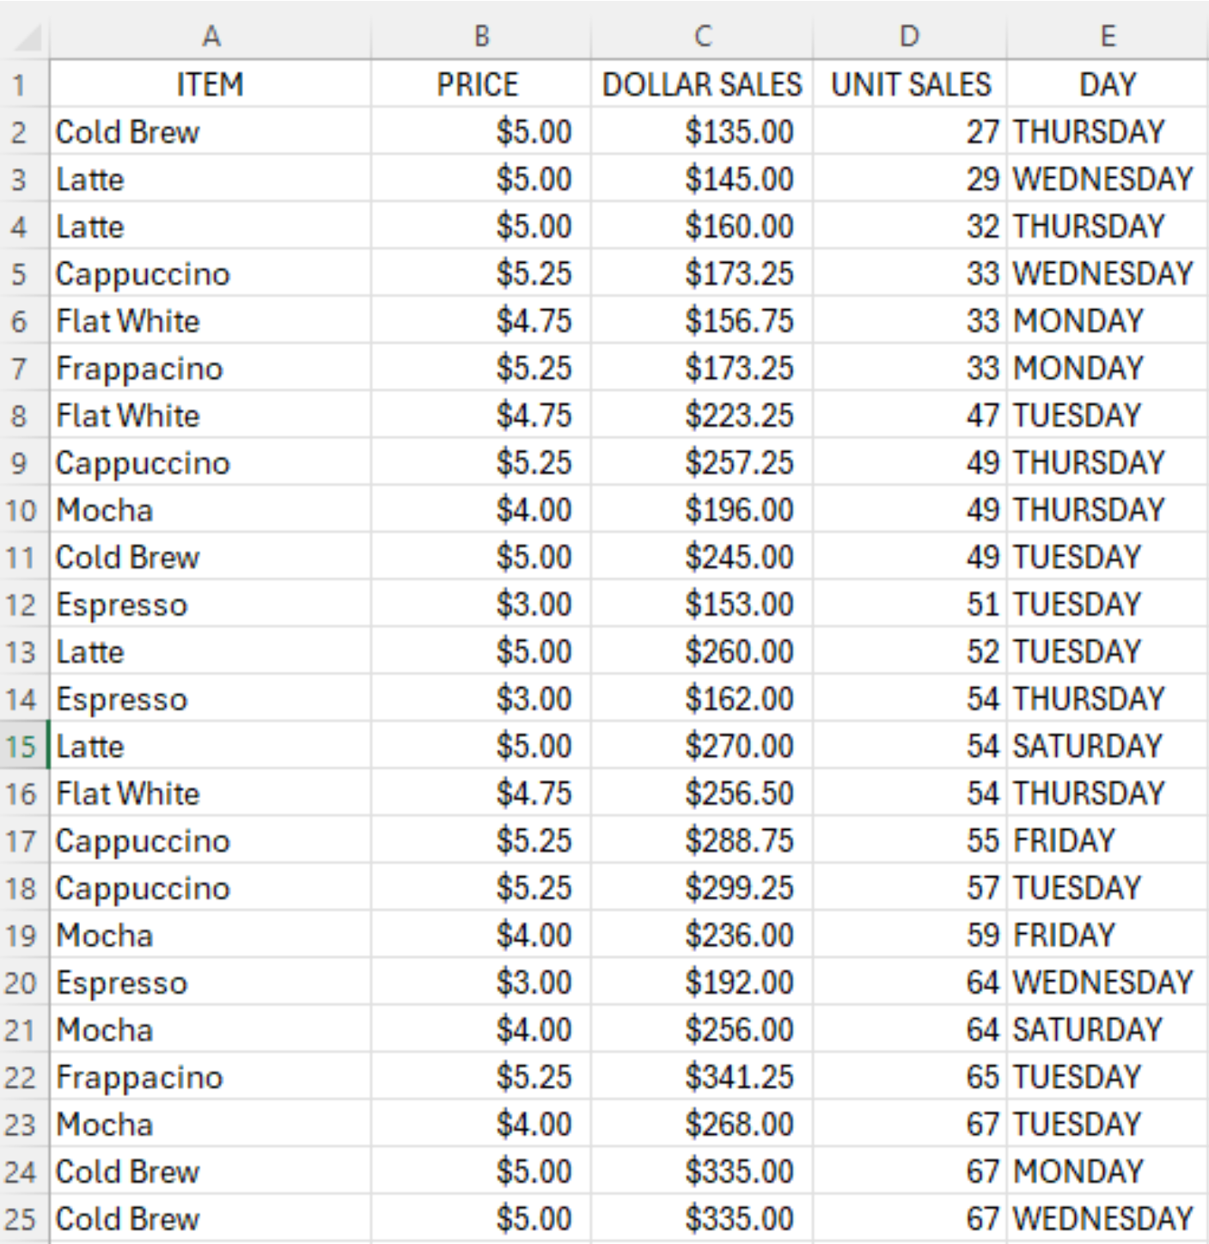
How Can Pivot Tables Help Manage Your Data? 1 of 2
Pivot tables take your data from this…

Slide 7
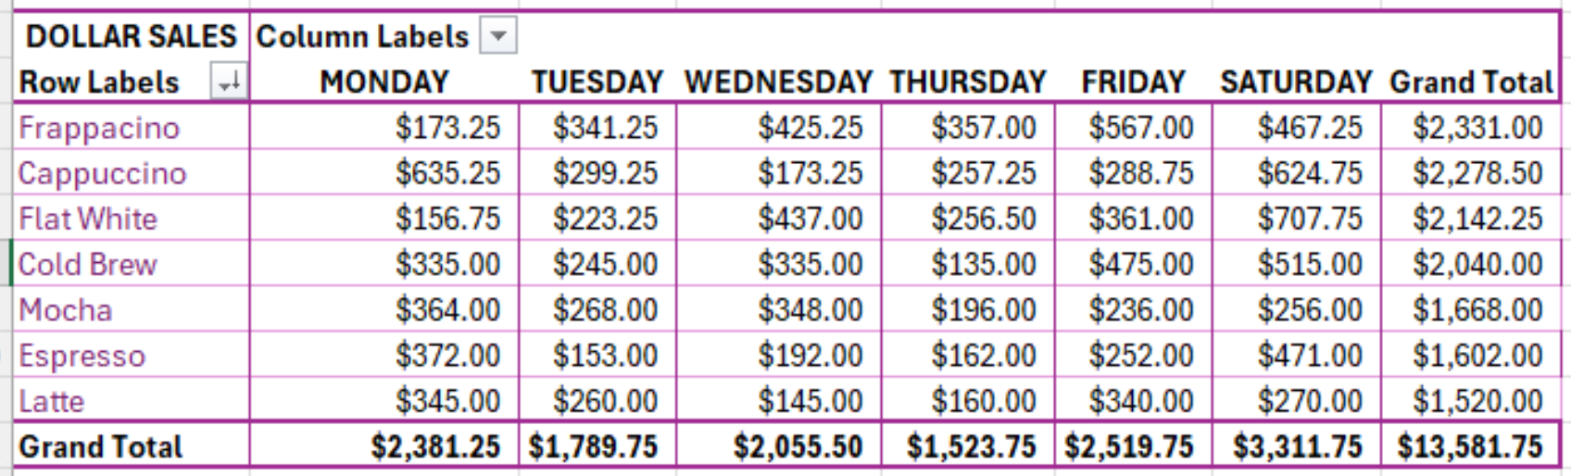
How Can Pivot Tables Help Manage Your Data? 2 of 2
…to this with just a few clicks!

Slide 8
Common Objections to Pivot Tables: 1 of 2
“I am unfamiliar with data management tools and thus unaware of what pivot tables are and how to use them”.
This guide will teach you about pivot tables and show you how to create them. Investing this short amount of time in learning about pivot tables is a great first step to improving how your business analyzes and presents data.
“I do not have the time to learn how to create and use pivot tables”.
Pivot tables save you time in the long-run! They allow for quick data organization and summaries to be created.
“I feel overwhelmed by pivot tables. They seem too complex to learn and I do not know much about Excel”.
While creating pivot tables in Excel might seem intimidating, the process is actually very user-friendly. With a bit of learning you can easily summarize thousands of rows of data into reports that are easy to read.
“My data is too disorganized to use pivot tables”
You can use pivot table features such as grouping, summarizing, and filtering to organize your data.

Slide 9
Common Objections to Pivot Tables : 2 of 2
“Other data management tools with more advanced features are more suitable for my needs”.
While advanced tools enable greater data analysis, they are typically more expensive, complex to set up, and involve more training. Pivot tables are already built into Excel, often making them more accessible and cost-effective.
“Simple tasks are better suited by more straightforward and basic analysis tools”.
Pivot tables can be simplified to better suit basic analysis. For instance, calculating trends or averages is much easier with pivot tables when compared to manual methods.
“Excel is unable to manage and process big data sets”.
While Excel does have its limitations, many businesses will find that Excel is still suitable for building pivot tables. Excel continues to improve its capabilities and even includes features such as Power Pivot for larger data sets.

Slide 10
How To Create Pivot Tables in Excel: 1 of 3
The 3 basic steps to create a pivot table:
Step 1: Prepare the Data – Gather relevant data and organize into tabular format
  Data should be organized with clear headers & no blank rows & columns (as displayed in the image shown).

Slide 11
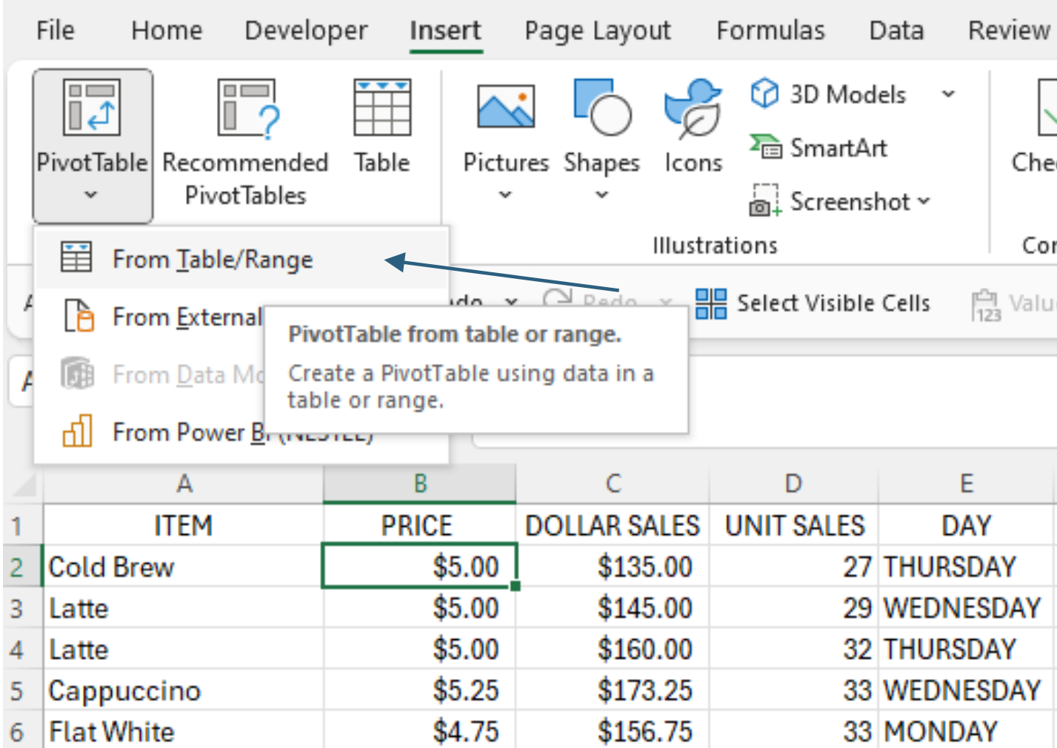
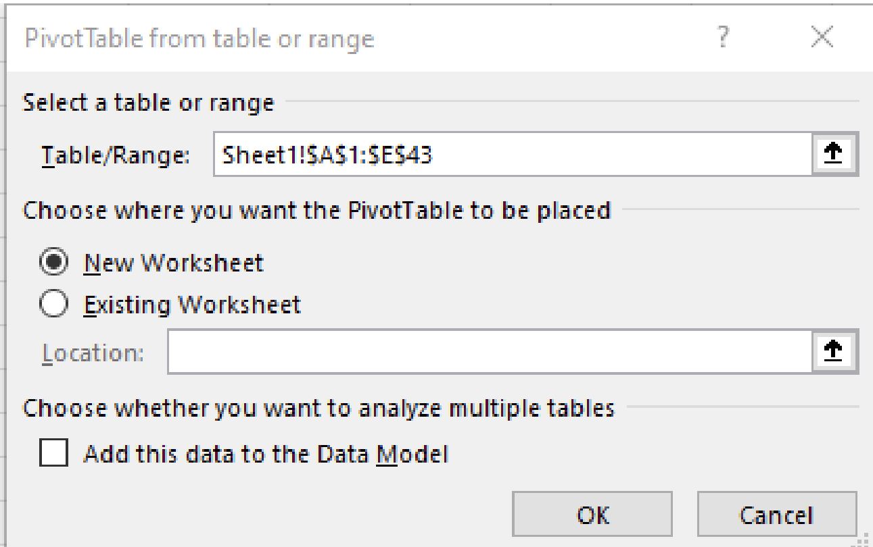
How To Create Pivot Tables in Excel: 2 of 3
Step 2: Insert the Pivot Table – 4 easy steps
  Select any cell in your data table
  Select Insert → Pivot Table → From Table/Range
  Select if you want your data to appear in new or existing worksheet
  Once you press “OK” the table will appear
Step 1 & 2
Step 3 & 4

Slide 12
How To Create Pivot Tables in Excel: 3 of 3
Step 3: Build the Table – Drag & drop desired fields into filters, rows, columns, or values
Filters
Columns
Rows
Values
This is the basic structure of how the feature looks. You can take any field of data & drag and drop it in any section to see how it changes the way the data is presented.

Slide 13
How To Create Pivot Tables in Excel: Example - 1 of 2
Latte Lounge Café wants to analyze its sales data for each menu item. They place their data into tabular format in Excel & create a pivot table. They aim to answer the following questions:
  What is my best-selling item?
  What is my worst-selling item?
  What day of the week do I have the most sales?
  What is the slowest day of the week?
A simple pivot table can organize their data to easily answer these questions…
Notes:
https://www.superchart.io/blog/ad-hoc-analysis-pivot-table

Slide 14
How To Create Pivot Tables in Excel: Example – 2 of 2
  What is my best-selling item?
  What is my worst-selling item?
  What day of the week do I have the most sales?
  What is the slowest day of the week?
Notes:
https://www.superchart.io/blog/ad-hoc-analysis-pivot-table

Slide 15
The Benefits & Limitations of Pivot Tables – 1 of 1
Benefits:
  You can build charts & graphs to visually communicate data.
  You can take unformatted data & quickly organize it to make sense of the information by rearranging fields, filtering data, or changing the format.
  Even when working with multiple datasets, pivot tables can consolidate and summarize data.
Limitations:
  Pivot tables do not automatically update when changes are made to your dataset. Instead, tables must be updated manually.
  Extremely large datasets may slow down Excel or cause the software to crash.
  Unstructured data often causes errors so data must be well-organized before creating pivot tables.

Slide 16
Common Challenges with Pivot Tables & How to Overcome Them – 1 of 1
Placing Fields in the Incorrect Areas:
  Challenge: Confusing or irrelevant output may occur if values are place in the incorrect areas.
  Solution: Rearrange data until it is in a format that makes sense. Keep in mind that a “value” must be a number (dollars, units, etc.)
    Example: If you are looking to figure out the total sales you had for each region & your data is placed in the following fields…
      Rows: Date
      Columns: Region
      Values: Product
          *Here you are placing a product where a value should be so the data will not display correctly. Instead, if you were to move product to a row or column & add sales to values then this would answer the initial question.
Duplicate Data:
  Challenge: Duplicate data can distort pivot table outputs.
  Solution: In Excel, you can use the feature “remove duplicates” to ensure data accuracy.

Slide 17
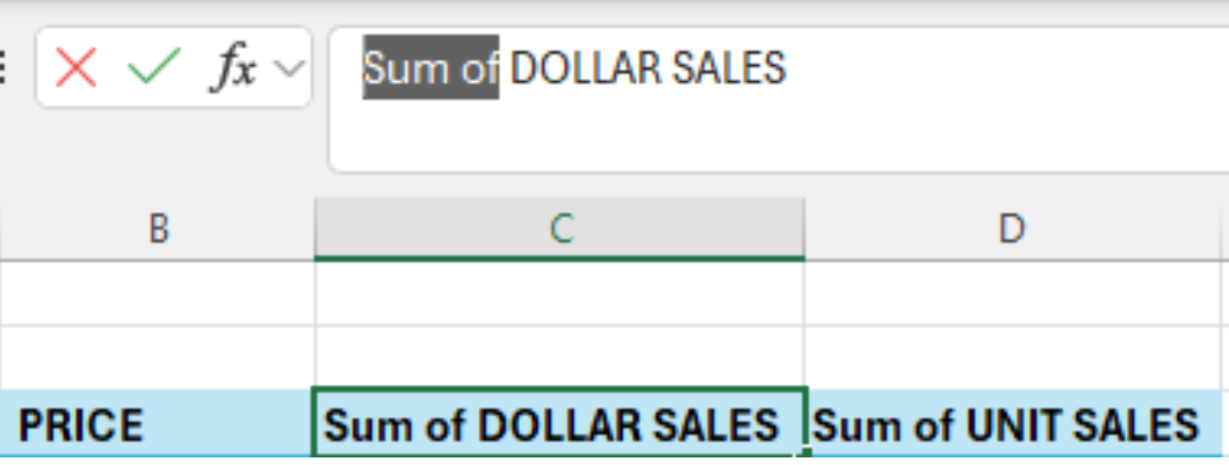
Tips to Improve Pivot Tables - 1 of 1
When trying to remove the phrase “sum of” in your data set you will get an error message saying that the field name already exists. To solve for this, you can add an extra space (at the beginning or end) after deleting the phrase.
Right click to sort data. You can arrange values from smallest to largest values or vice versa.
You can manually change the order of your data. Just click and drag the item and place it in the desired location or order.
Under design, you can pick from various layouts.
Right click the pivot table & select refresh to update. If new data has been added to your existing spread sheet, then this data will be reflected.
Removing the phrase “Sum of”

Slide 18
Additional Resources – 1 of 1
How to Create Pivot Tables in Under 10 Minutes
(Videos provide a step-by-step tutorial for how to create tables)
Pivot Table Excel I Step by Step Tutorial by Kevin Stravert https://www.youtube.com/watch?v=dvbLrwD2SpA
Excel University: Excel Pivot Tables for Beginners (2025) by Jeff Lenning https://www.youtube.com/watch?v=Vj8SNnat2FA
Case Studies in Under 15 Minutes
(The different ways to manipulate data for greater insights)
Excel Maven: Excel PivotTable Case Study: Analyzing Stock Market Data https://www.youtube.com/watch?v=8Dp1s1_R2kA
Excel Maven: Excel PivotTable Case Study: Analyzing Shark Attack Records https://www.youtube.com/watch?v=h5xf_2o9WTg
Cheat Sheets for Creating Pivot Tables
(Information guides for quick reference)
Lumeer: Pivot Table Cheat Sheet https://www.lumeer.io/pivot-tables-cheatsheet
Myexcelonline.com: Pivot Table Cheat Sheet https://www.myexcelonline.com/wp-content/uploads/2017/04/Pivot-Table-Cheat-Sheet-New.pdf

Slide 19
Thank You!
This information was created & presented by Sarah Gessler.
  My Contact Information:
    LinkedIn Profile: www.linkedin.com/in/sarah-gessler-33606a2a5
Thank you, Grace LaConte (LaConte Consulting), for providing valuable feedback & suggestions on materials.
  LaConte Consulting Website & Contact Information:
    LaConte Consulting Website: https://laconteconsulting.com/
    LaConte Consulting Contact Information: https://laconteconsulting.com/contact/

